Slide 1
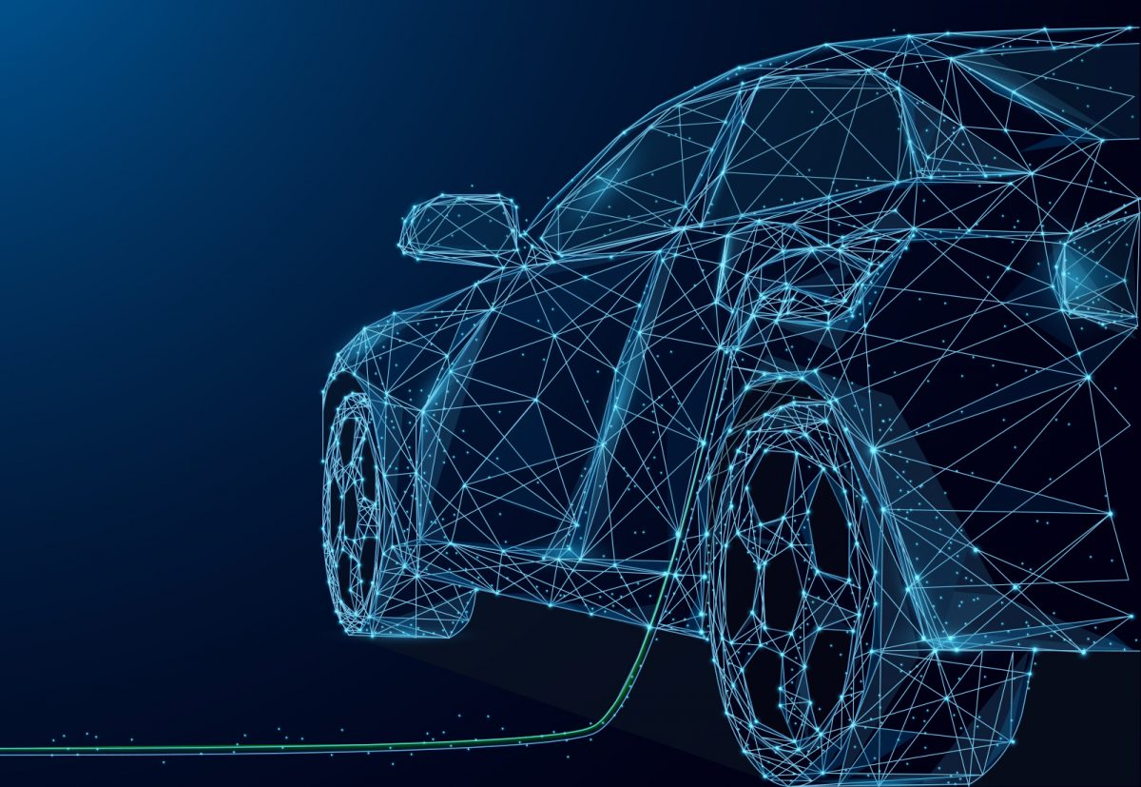
Driving the Future: An Analysis of Electric Car Sales in the State of Washington
by
Angel Flores
Robert James
David Campos
Yu-Hsi Chen
Dustin Oakes
Patricia Roa

Slide 2
Premise
An imaginary client wants to open a used car dealership in Washington State.
They want to specialize in either fuel efficient hybrid vehicles or battery-powered electric vehicles.

Slide 3
Premise
They want to stock the most popular make of car for the area that they open their lot in.
They plan on opening their lot in an area where a lot of new cars are sold in order to make buying and reselling vehicles easier in a market full of potential buyers.

Slide 4
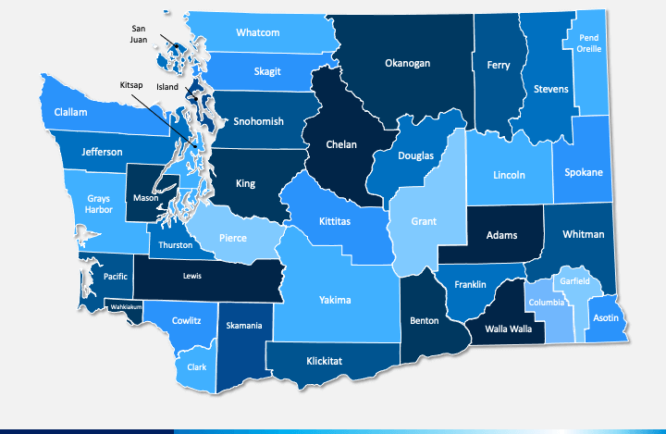
OUR INQUIRIES OF ELECTRIC VEHICLES IN WASHINGTON:
Which type of electric vehicle is more popular? Battery-Electric or Hybrid Electric?
Which brand of electric vehicles is the most popular in Washington? And which brand is most popular in each county?

Slide 5
OUR INQUIRIES OF ELECTRIC VEHICLES IN WASHINGTON:
3. Which areas in Washington are electric vehicle sales significantly high?
4. In which counties of the state are the electric vehicle sales the lowest in volume?

Slide 6
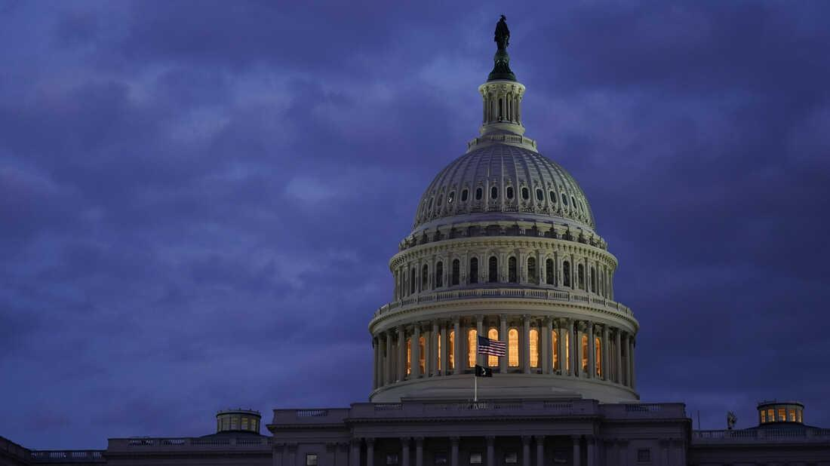
Our Data
Our findings are based on a dataset from https://data.wa.gov/, which contains hybrid and battery-electric cars registered and sold in Washington State.

Slide 7

Our Data is Clean
Data was cleaned to fit the subject of our inquiries:
1997 - 2010 model sales were removed. They accounted for 68/109,481 (.06%) of data.
Data about vehicles sold in other states that were then registered in Washington were removed.
Irrelevant columns and duplicates were removed.

Slide 8
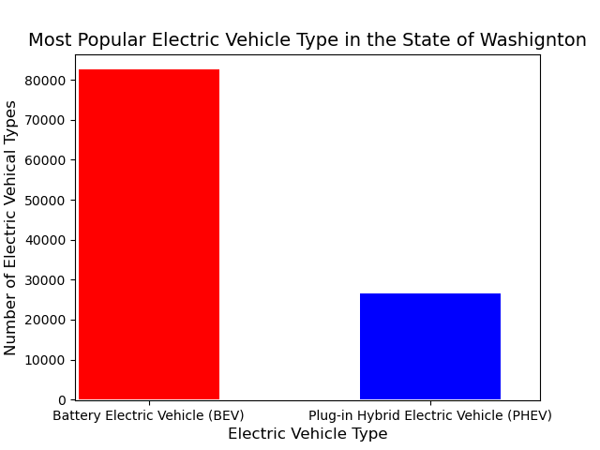
Currently, Battery Electric Vehicles outnumber Plug-in Hybrid Electric vehicles by nearly 3x.
Since 2011 there has been a total of 82,575 BEV registered in the state of Washington compared to only 26,555 PHEV.

Slide 9
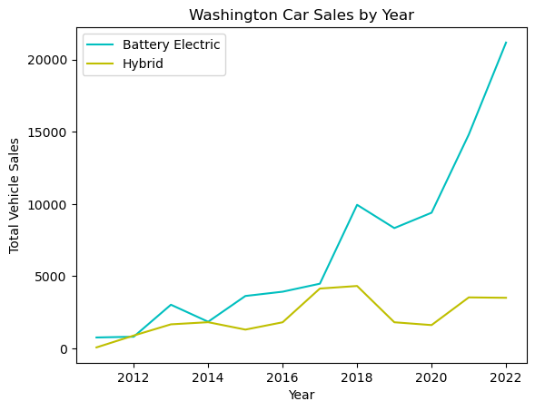
Line graph showing the trend of car sales by their model year.
Battery Electric Vehicle (BEV) sales have consistently outperformed Hybrid vehicle sales in WA.
Despite newer models entering the market for both electric car types, hybrids decline and battery increases significantly.

Slide 10
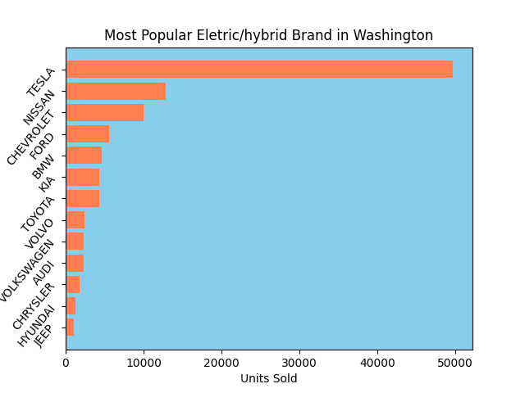
Bar graph of brands with 1000+ units sold.
Even if electric car sales for Nissan, Chevrolet, and Ford were combined, Tesla still owns the market in Washington.
The least popular brands for electric cars are Chrysler, Hyundai and Jeep.

Slide 11
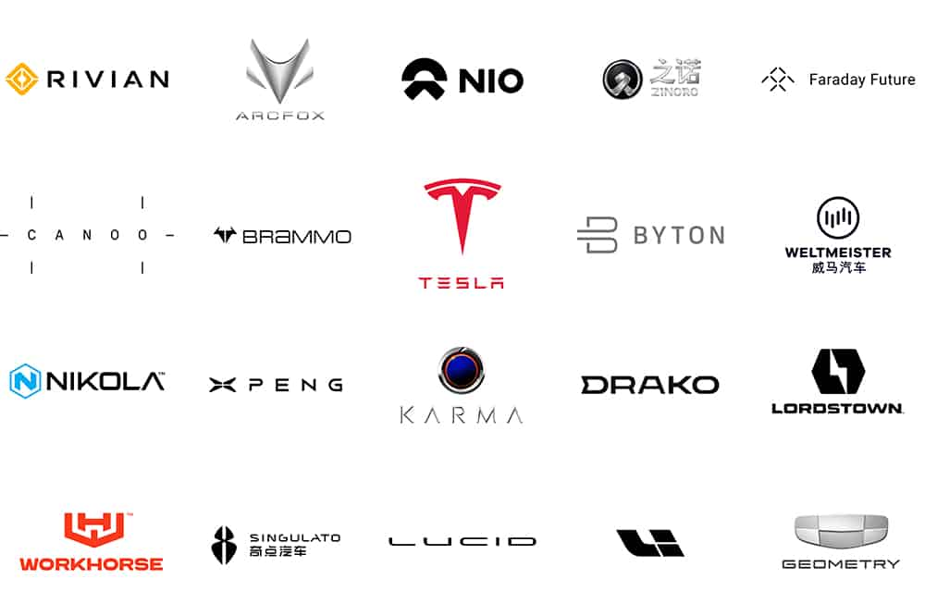
Key Findings of Electric Car Sales in WA
Electric Battery Vehicles are more popular than Hybrid-Electric Vehicles
Despite newer Hybrid-Electric car models entering the market, this type of vehicle is steadily declining in sale.
Tesla is the highest selling electric car brand in the state of Washington.

Slide 12
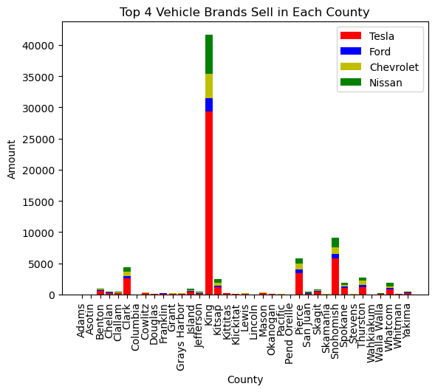
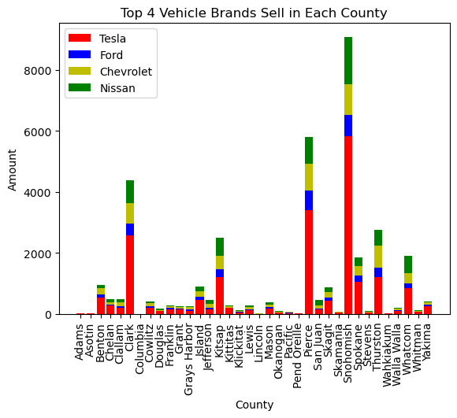
Top 4 Selling Electric Car Brands in each county
Without King County

Slide 13
Key Findings
Tesla is the most popular electric vehicle brand in each county.
Without the giant Tesla, Nissan is thriving in electric car sales in all counties.
King county is area that sold and owns the most electric vehicles, followed by Snohomish, Pierce, and Clark county.
There is a direct positive correlation between electric vehicle sales and county population observed.

Slide 14
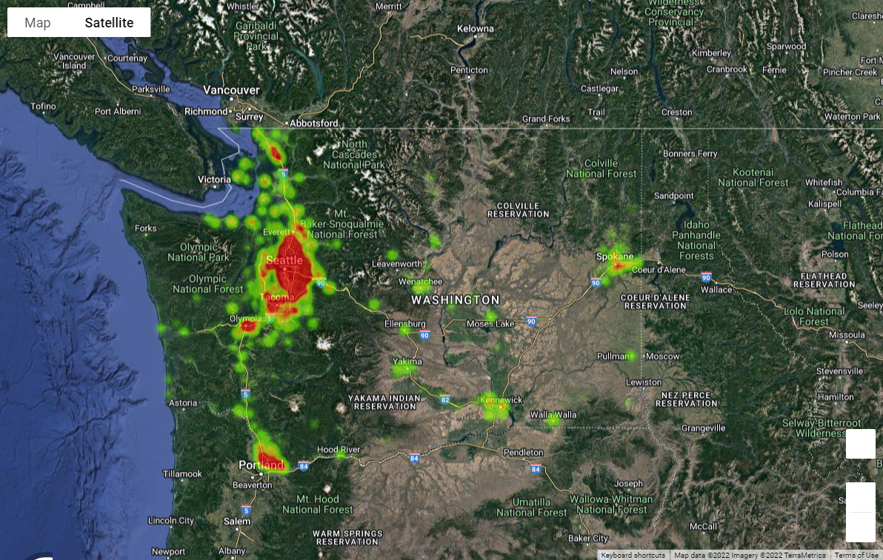
Heatmap: Volume of Battery and Hybrid Car Sales in Washington

Slide 15
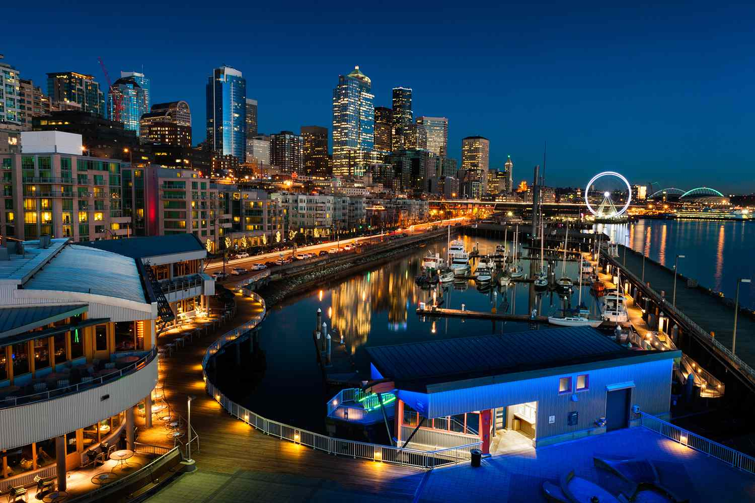
Findings of the Heatmap
To create the heatmap, we used the gmaps api.
By extracting the coordinates and plotting the longitude and latitude with the point-of-sale, it can be observed that:
More cars tended to be sold in places with higher population density.
Portland, Tacoma, Olimpia, and Spokane were all areas of high sale volumes, but Seattle had the most electric car sales.
Notes:
The cleaned data source already had the point-of-sale coordinates for each car, so after doing a .groupby() and .count() on that column, all that had to be done was to extract the coordinates column into useable series for Lat and Lng, and to use the Count totals as the intensity.

Slide 16
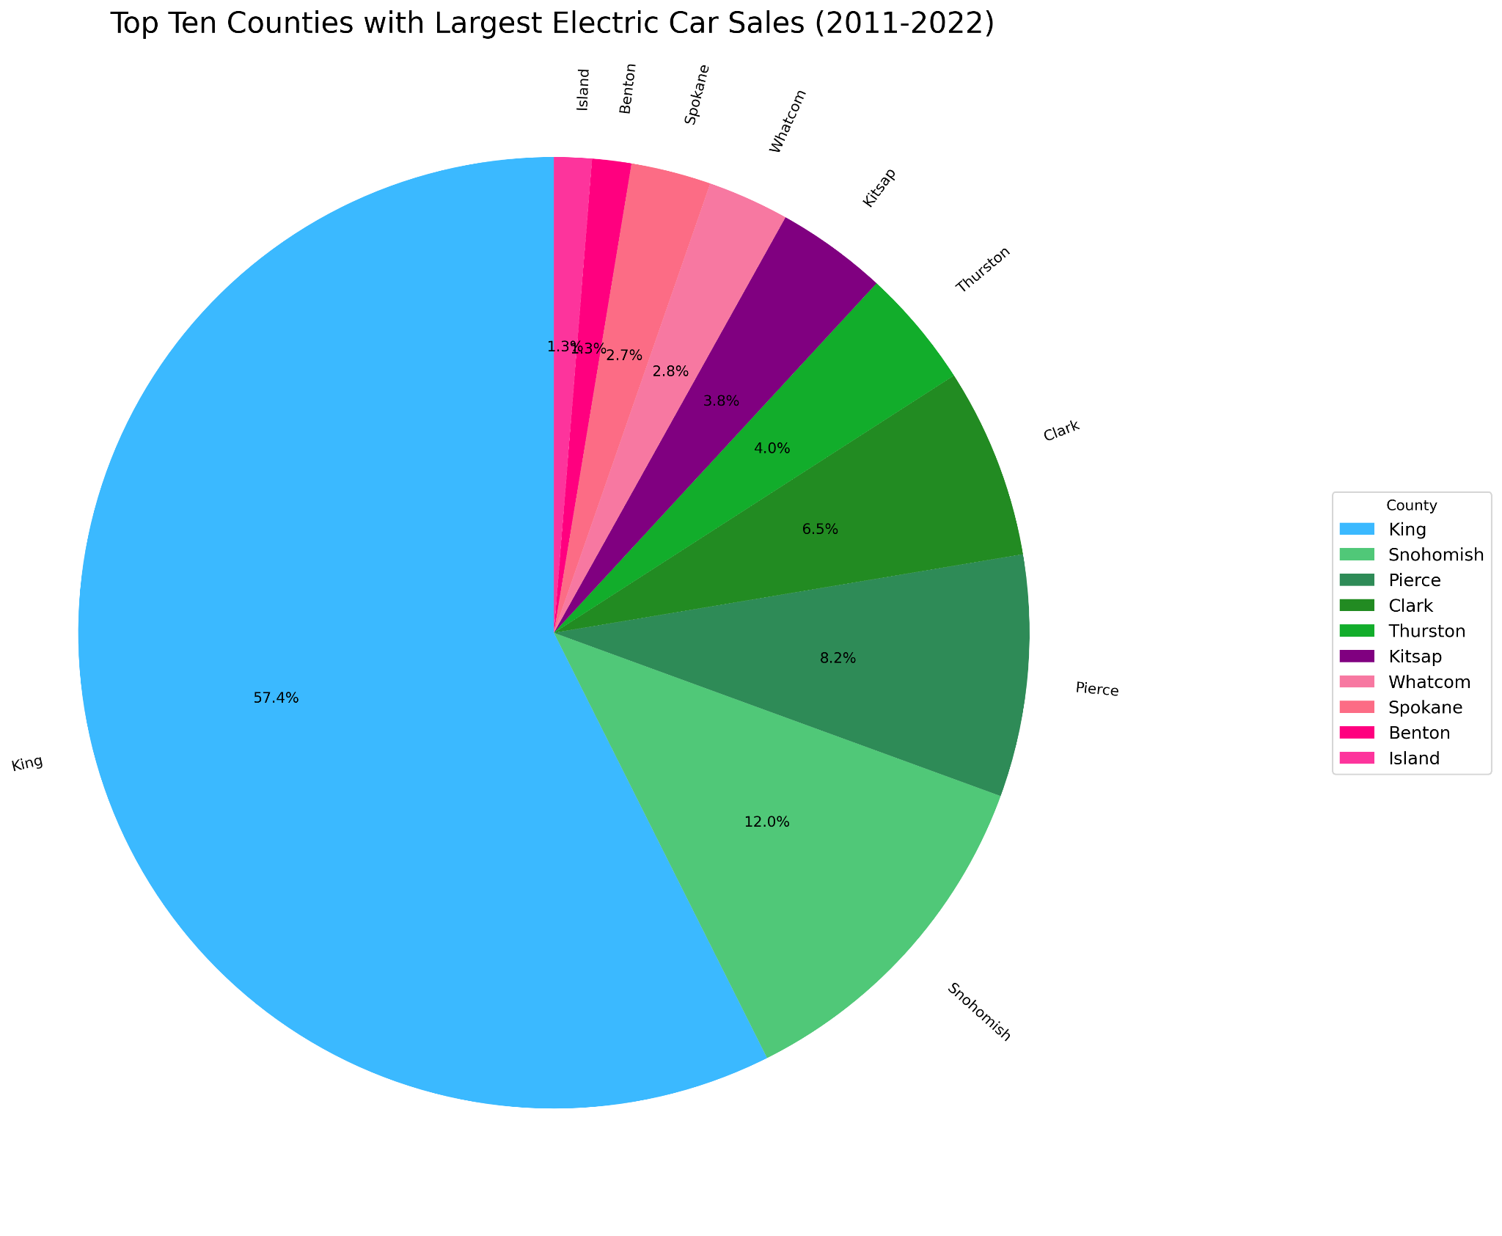
There are 109,137 electric cars sold and registered in WA.
King County sold and owns the most electric vehicles followed by Snohomish and Pierce.
King County accounts for 52.6% of all electric cars in WA with 57,360 e-vehicles sold and registered.
Snohomish - 12,018 EV’s (11%)
Pierce - 8,211 EV’s
(7.5%)

Slide 17
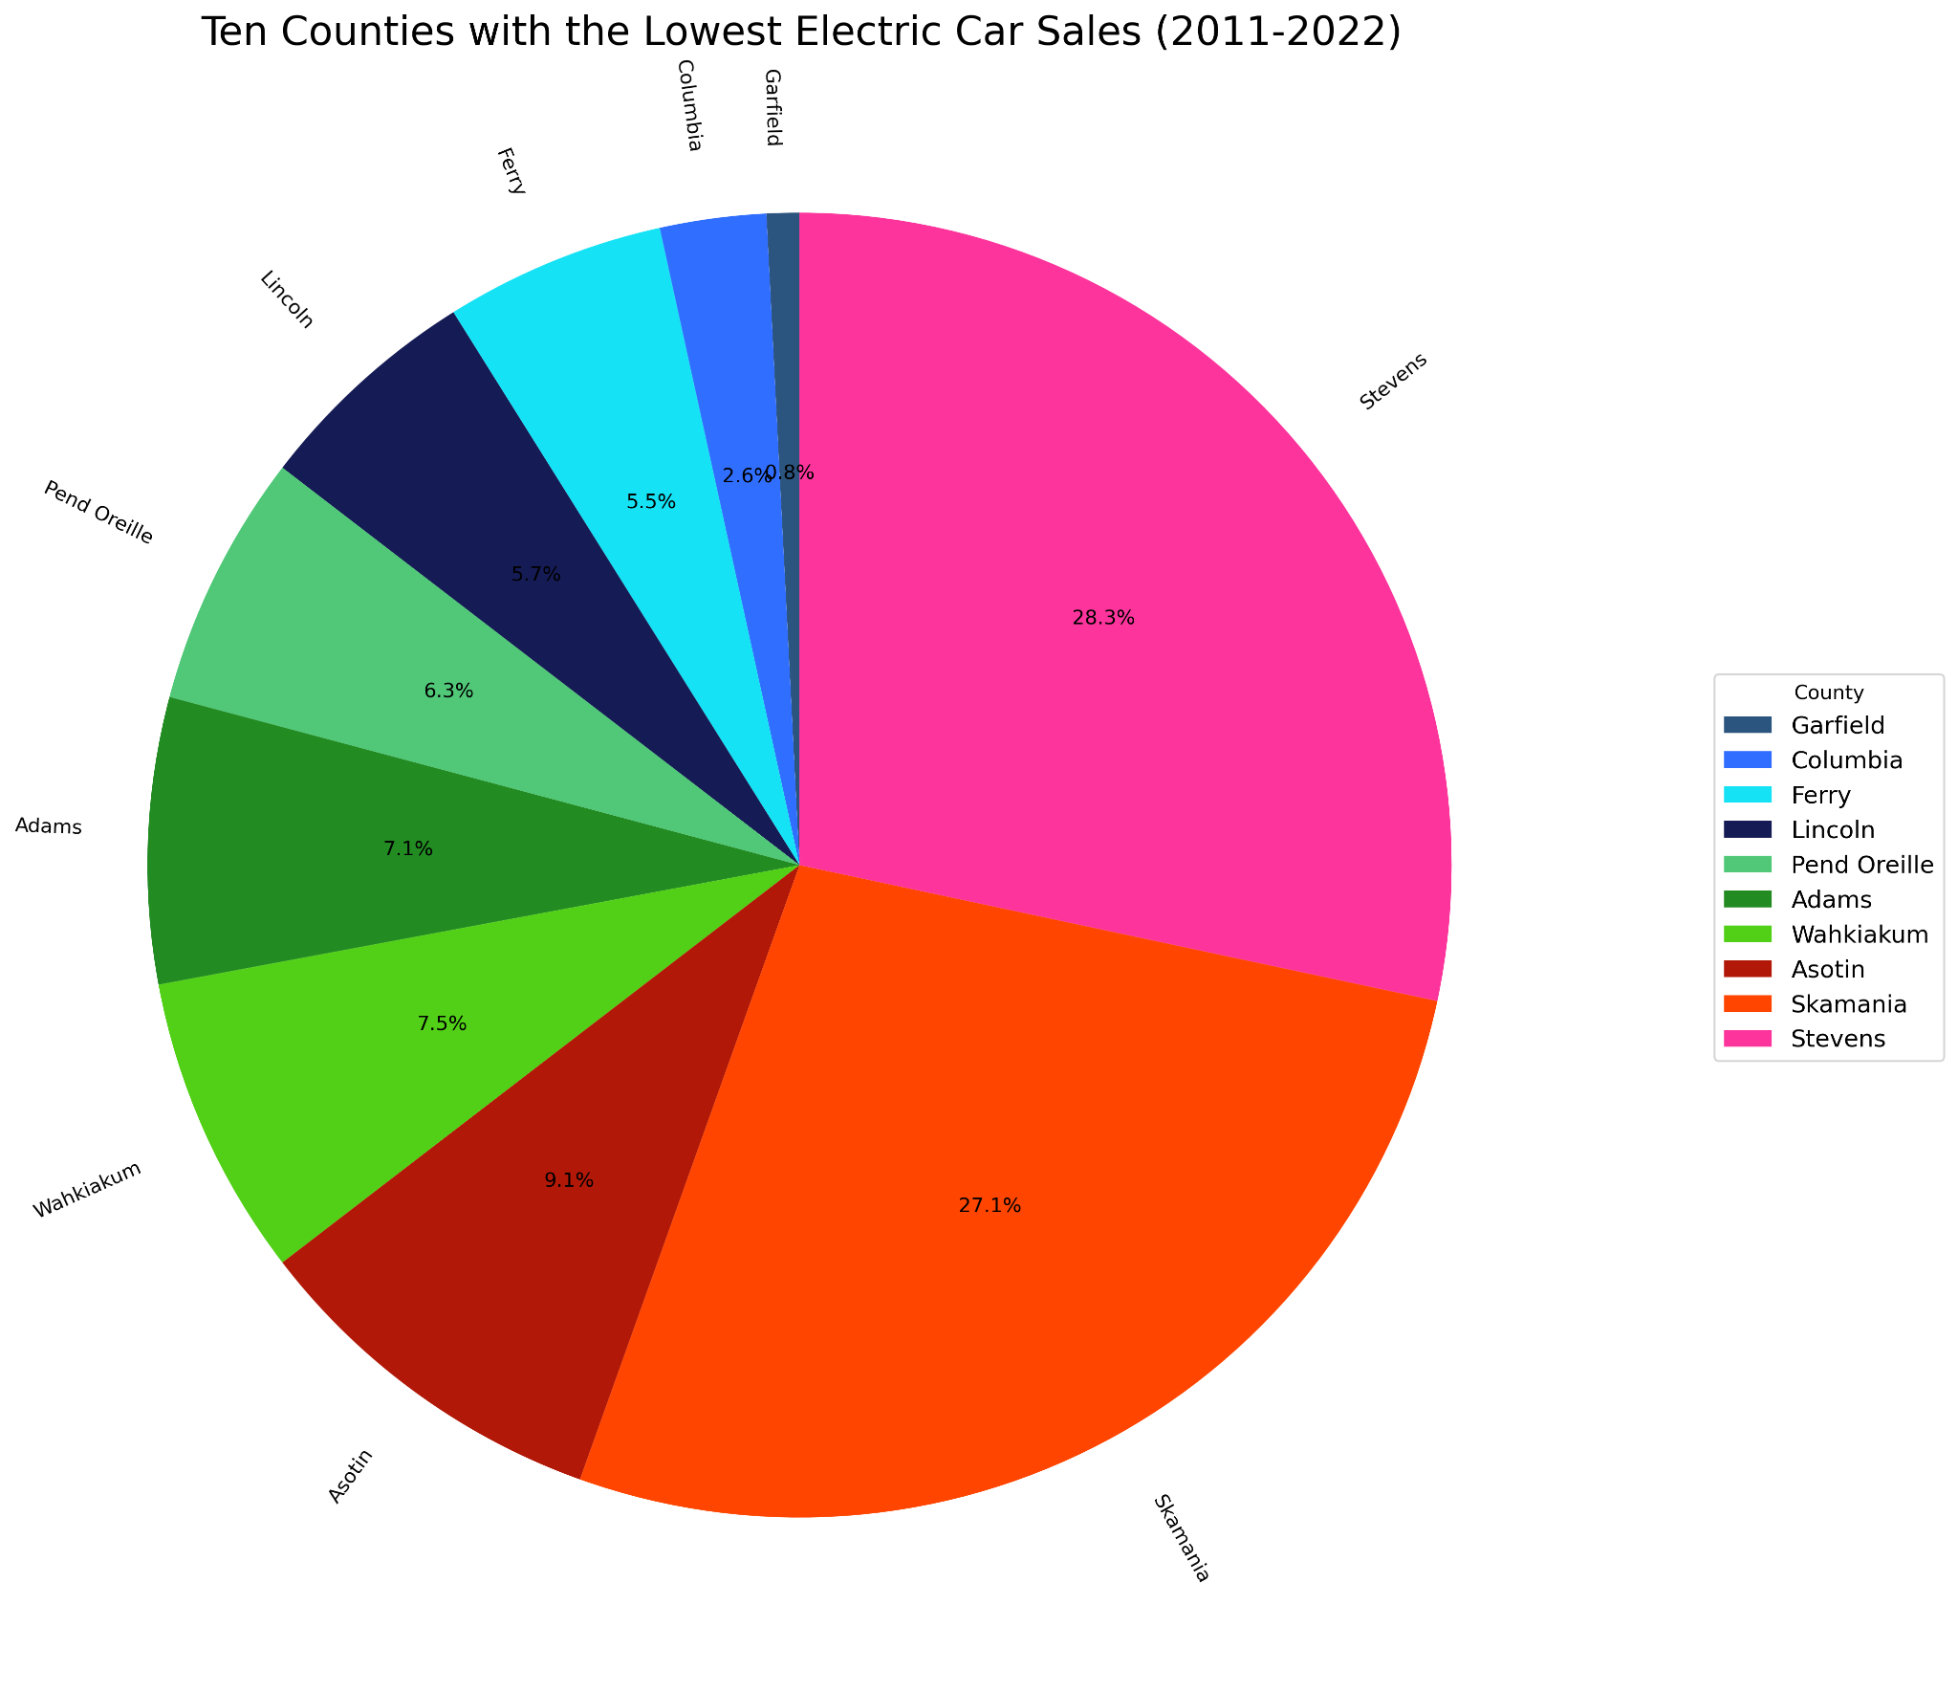
The county of Garfield had the overall lowest electric car sales over the last decade with only 4 electric cars registered and sold. (0.003%)
Columbia - 13 EV’s (0.01%)
Ferry - 27 EV’s (0.02%)

Slide 18
Conclusions
Battery electric vehicles are the most popular selling type of electric car.
Tesla is the most popular brand of electric vehicle in the state of Washington. Tesla is also the most popular brand in every county in Washington.
Electric Vehicle sales are significantly high in King County, followed by Snohomish and Pierce.
Electric Vehicle sales were extremely low in counties Garfield, Columbia, and Ferry.
Notes:
Answer the questions we mentioned in the beginning. And list the key findings in each graph.

